Slide 1
Scholar Plot – Scalable Data Visualization Methods for Academic Careers
Kyeongan (Karl) Kwon
PhD Dissertation
Advisor: Dr. Ioannis Pavlidis
Department of Computer Science
University of Houston
Monday July 18, 2016
Notes:
Thank you for coming for my presentation today.
My name is Kyeongan Kwon.
Today, I am going to present my PhD dissertation about scalable data visualization for academic careers.

Slide 2
Overview
Introduction
Design Philosophy and Methodology
Architecture
Data Analysis
Demo – www.ScholarPlot.com
Acknowledgment
Notes:
This is overview about today’s presentation.
In introduction, I am going to talk about the research problem and related works.
In Design philosophy and methodology, I am going to cover design philosophy and how the philosophy apply to the product.

Slide 3
What is Data Visualization?
Data visualization is the presentation of data in a pictorial or graphical format
Facilitate intuition
Support qualitative analysis
Notes:
Before starting to present my research,
I would like to talk about a little bit what data visualization is exactly.
There are many benefits of it, however, I point out two main things.
Qualitative analysis is the scientific study of data that can be observed, but not measured.

Slide 4
Why Data Visualization Matters?
Visualization facilitates data access
Visualization brings up patterns and pattern violations
Visualization supports actionable insights
Visualization aids in the comprehension of big data
Notes:
Because of the way the human brain processes information, using charts or graphs to visualize large amounts of complex data is easier than poring over spreadsheets or reports.

Slide 5
Introduction
Appraising academic careers
Hiring faculty
Promotion and Tenure
Peer-reviewing
Matching students to advisors
Notes:
A Good Research Problem
There are difficult and time consuming tasks
when Appraising academic careers.
For examples,

Slide 6
Introduction
Curriculum vitae (CV)
Lengthy
Often convoluted
With potential errors / misses
Inconsistent content & form
Difficult and time consuming to analyze academic CVs
Methods that can help
Data Science / Data Analytics / Data Visualization
… 30, 40, 50 ... pages
Notes:
CV is still very popular to evaluate.
- it is where your publishing and research history as well as your memberships and fellowships.
Why it is inconsistent. For example, the way people list their publications is inconsistent.
Journal (IF or not) , Conference (Acceptant rate or not )

Slide 7
Goals of Research
GOAL 1: Articulate a clear, comprehensive, and measurable performance evaluation scheme for academics
The scheme should reveal causal relationships among merit criteria
The scheme should be scale invariant
GOAL 2: Design a visualization to bring the said performance evaluation scheme to life
GOAL 3: Implement and test the said visualization, drawing from actual public data
Notes:
Three are three goals of research.

Slide 8

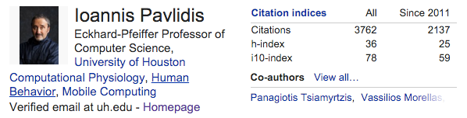
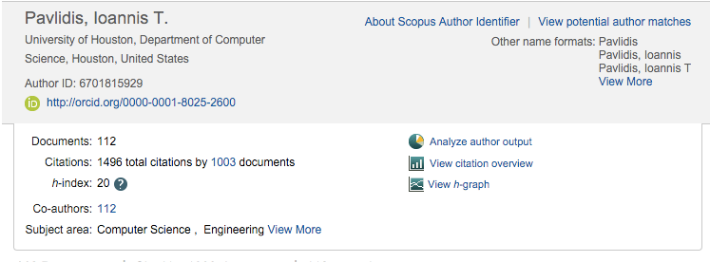

Related Work - Software
Missing about 2,000 citations, 16 h-index
Google Scholar
+ Free; inclusive
- Publications only; little visualization
Scopus
- Subscription based
- Not as inclusive as Google Scholar
ORCID
+ Publications; funding
- Requires extensive set-up
Notes:
Some related works is out three. Software products.

Slide 9
Related Work - Literature
Article | Author | Year | Conclusion
“Visualization of the citation impact environments of scientific journals” Journal of the American Society for Information Science and Technology | L Leydesdorff | 2007 | Effort focused on visualizing citation patterns using a journal data set
“Augmenting the exploration of digital libraries with web-based visualizations” IEEE Fourth International Conference on Digital Information Management (ICDIM 2009) | P Bergstrom D Atkinson | 2009 | Exploring patterns in the literature using a static data set at CiteSeer
“SciVal experts: A collaborative tool” Medical Reference Services Quarterly | E Vardell T Feddern-Bekcan M Moore | 2011 | Summary of researchers’ profiles using Scopus
“Scholarometer: A system for crowdsourcing scholarly impact metrics” Proceedings of the 2014 ACM Conference on Web Science (WebSci 2014) | J Kaur M JafariAsbagh F Radicchi F Menczer | 2014 | Citation analysis using Google Scholar, but no Impact Factor and no funding information
Notes:
Also there are some literature related work.

Slide 10
What Is Missing?
Unambiguous scheme for academic performance
Summary interface to facilitate executive decisions
Scholar Plot fills the gap
Well-thought scheme for academic performance
Visual summary
Notes:
There is no definitive scheme for evaluating academics.
Because everybody has own ideas.
Big journal is good, many cited publication is also good.
This isn’t clear, how it is related to each other.

Slide 11
Design Philosophy
Merit criteria for evaluation of academic performance
Impact
post-production merit
Prestige
pre-production merit
Funding
enabler of production
Visualization
Impact linked to vertical axis - visibility
Prestige linked to disk size - fancy factor
Funding placed at the bottom - causality
2
1
3
Notes:
Let me tell you how I structured this visual abstract based on three merit criteria.
- Impact of the intellectual products, what happened after you published.
- Prestige of the venues where intellectual products appear, How famous’ places where you published.
- Funding that enables intellectual production
Why impact on the vertical scale is not a Impact Factor,
but citation because of the fixed scale of Impact Factor (1-60), citations could reach 100,000

Slide 12
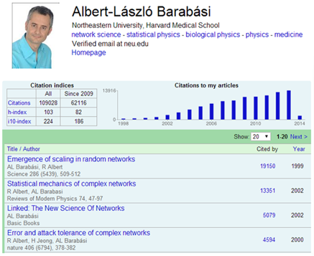
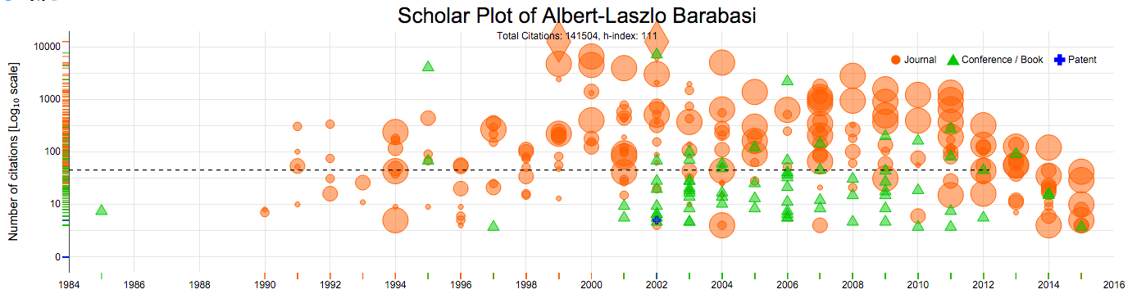
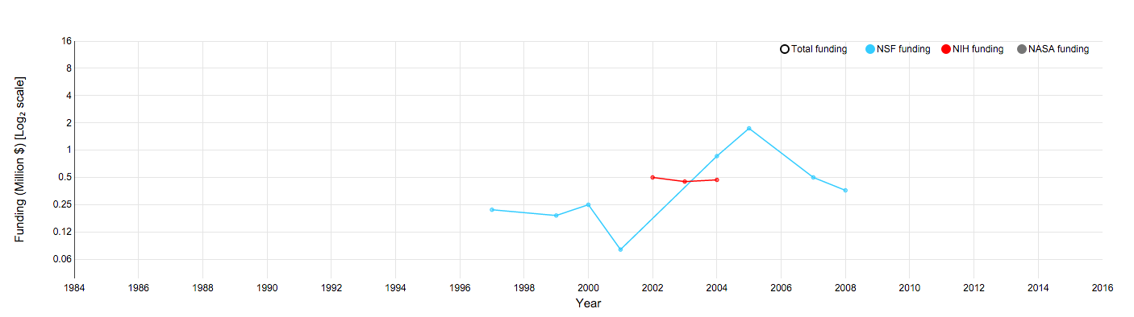
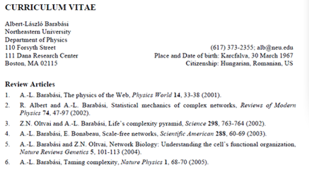
Design Methods
A. Google Scholar Profile
C. Scholar Plot
B. Curriculum Vitae
Notes:
I have three figures of the same scholar in order to see the difference.
Google Scholar Profile. Only one bar chart ; publication list
Curriculum Vitae, a brief account of a person's education, qualifications, and previous experience.
However, Scholar Plot brings more but simply. It includes all the publications with different colors and symbols which lead people could distinguish type of publication quickly. It also includes funding information.

Slide 13
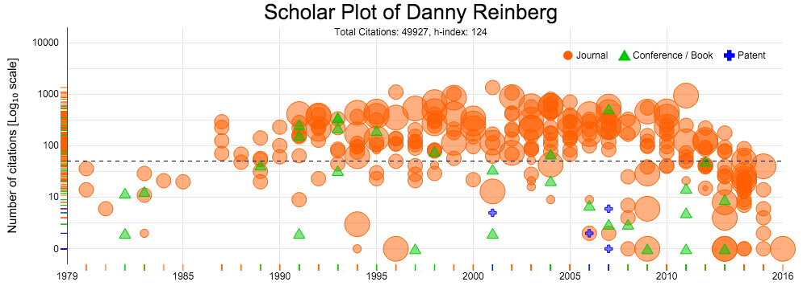
Design Methods
Visualization of Publication Record
Notes:
This is one result of a scholar who have about 300 publications includes all Journal/ Conference and Patents.
It is easy to identify what type of publication powers the individual’s scholarship.

Slide 14
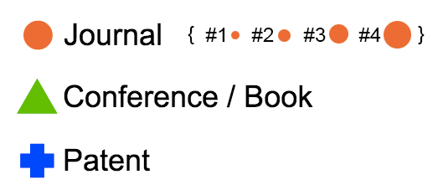
Design Methods – Prestige
Publication symbols
Journal (A ~ r²)
Conference / Book
Patent
Disk sizes for prestige visualization
IF bracket ( IF < 2) - #1
IF bracket (2 ≤ IF < 4) - #2
IF bracket (4 ≤ IF < 16) - #3
IF bracket (IF ≥ 16) - #4
 | IFs | Journals
#1 | <= 2 | 5554
#2 | 2 - 4 | 1948
#3 | 4 - 16 | 808
#4 | 16 >= | 62
Journals
* IF - Impact Factor
IF
Notes:
How Differentiate different prestige
Journal has little different prestige because it has only a widely accepted ranking system that is the Journal Impact Factor.
Conference has acceptance rates and some general guide line to tell the rank of conferences like A+ / A. However, some has no these information.
Patents have no this type of information.
We chose disks to be the symbols of journal publications, as disk scaling can be done very effectively by simply varying its radius (A ∼ r2).
Size
How do I present this value from lower to higher IF.
I did some data analytics for this.
Frequency of Journal published by Thomson Reuters
Four categories based on histogram analysis. I use this to commensurate the size of disk.

Slide 15
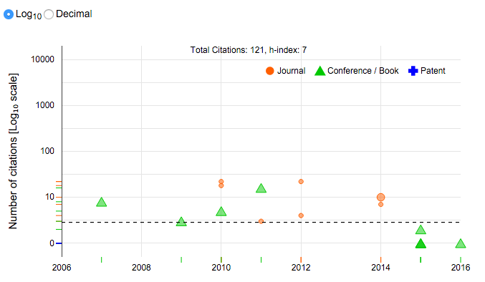
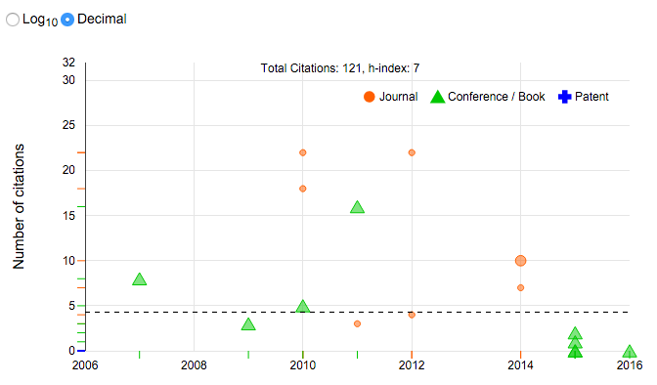
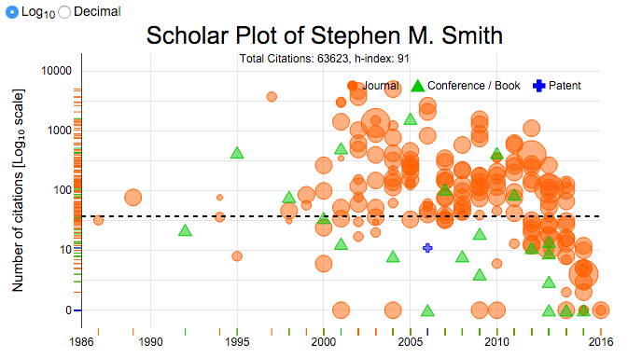
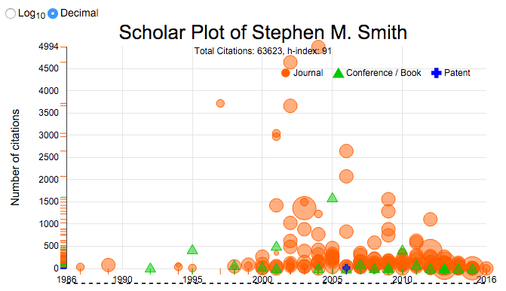
Design Methods – Impact Scales
Log and Decimal scales
Senior records vs. junior records
Log₁₀ (Default)
Decimal
Notes:
Two different scales views to create a standardized scale for the y-axis for comparison, I introduced a log10 scale for the default plot and an option to toggle to the decimal scale view.
If you have a senior records, and put it as a decimal scale, it suppress visualization.
However, junior records isn’t important because you hardly can see the difference.
That’s why Logarithm is default. It makes the difference visibility.

Slide 16
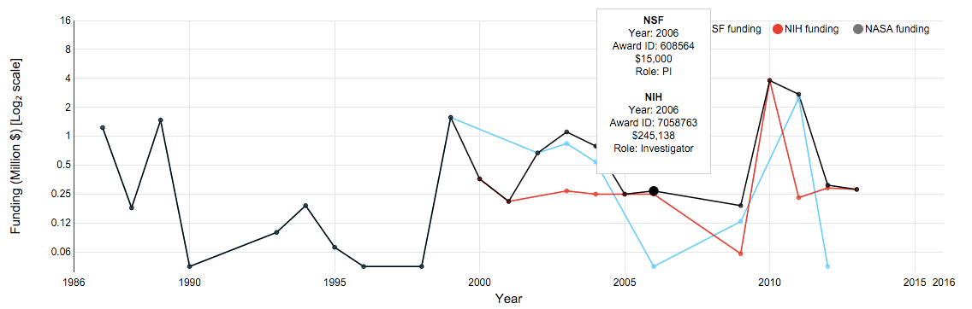
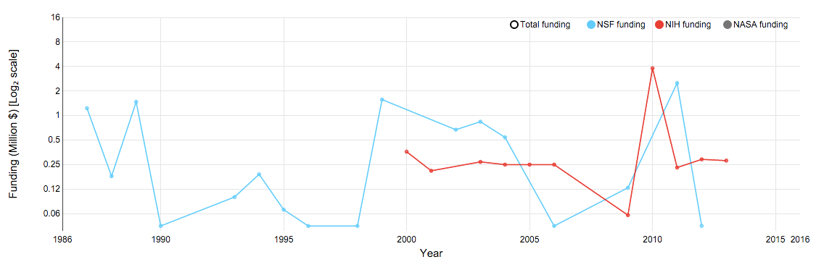
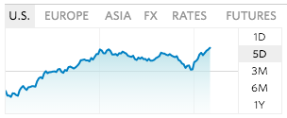
Design Methods - Funding
Tooltip displays details
Agents, Year, Award ID, Amount and Roles such as PI, Co-PI, Investigator
Notes:
Scholar Plot also depicts the NSF/NIH/NASA funding of an individual as a multiline in log₂ scale
Line Chart is proper for me to use visualizing funding data because it is commonly used like stock markets.

Slide 17
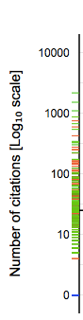
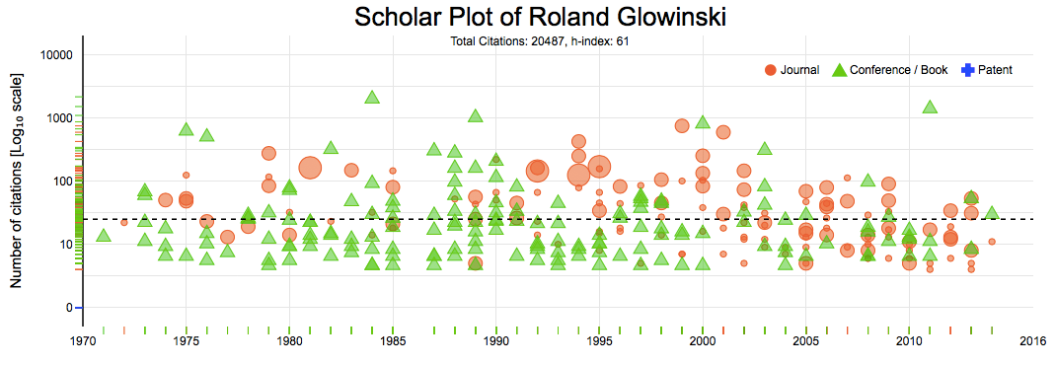
Design Methods – Ranked Density of Publication Types
Examples of different scholarly profiles
Mix of journal and conference papers
A
Notes:
There are some patterns of scholarly profiles.
I bring three example.
not necessarily look at the main plots, you can simply see the vertical projection and tell the type of patterns.

Slide 18
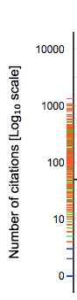
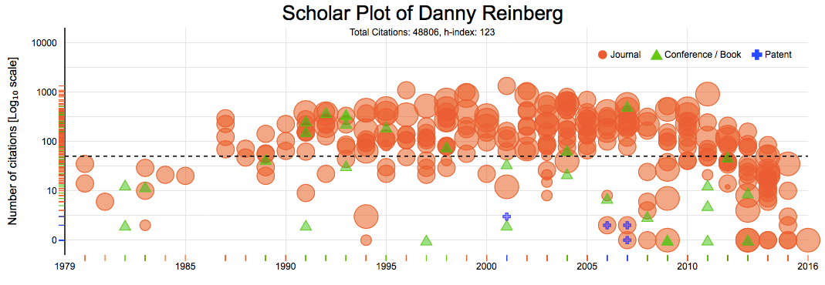
Design Methods – Ranked Density of Publication Types
Examples of different scholarly profiles
Mix of journal and conference papers
Preponderance of journal papers
B

Slide 19
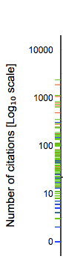
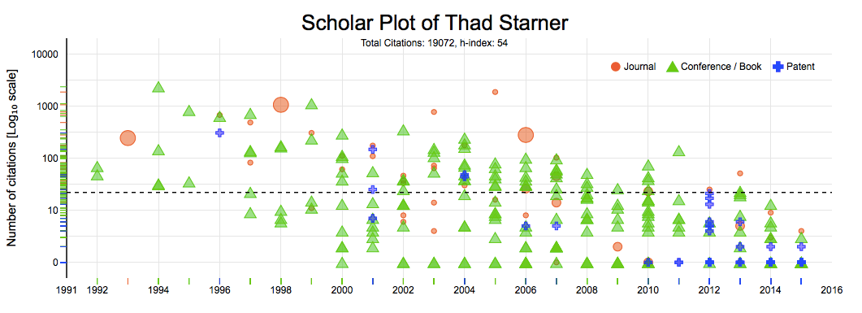
Design Methods – Ranked Density of Publication Types
Examples of different scholarly profiles
Mix of journal and conference papers
Preponderance of journal papers
Mix of conference papers and patents
Why this is useful?
Aids in comprehending the scholarly profile
Reveals the type of publication producing the biggest impact
A
B
C

Slide 20
Prototype!
Notes:
Now I had a prototype including publication records and funding records.
I wanted to make it improved.
So, I gave two evaluations both focus group and user study.

Slide 21
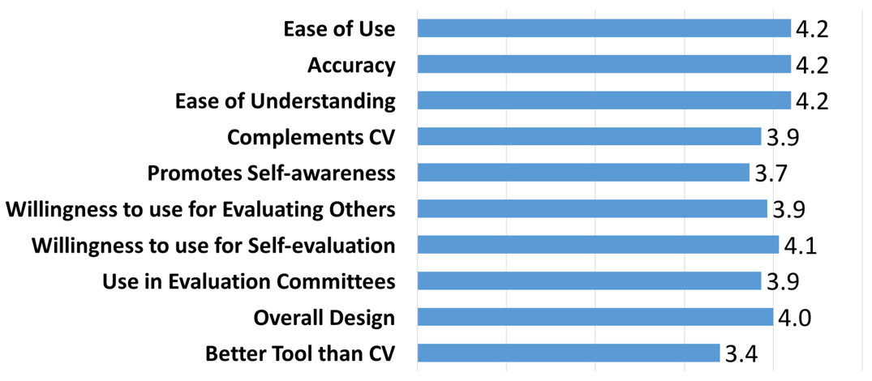
Evaluation - User Study
Participants (n=15) included graduate students, postdocs, and faculty from natural, mathematical and social sciences
Likert scale from 1 to 5, with 1 being strongly disagree and 5 being strongly agree
Conclusion: Scholar Plot is a friendly tool that academic users find of interest and value
Notes:
A total of n = 15 participants from various natural, mathematical, and social sciences participated in the user study.
Usability, accuracy and intuitive understanding of Scholar Plot scored the highest (μ = 4.2).
The participants were planning to use Scholar Plot frequently (μ = 4.1).
Overall, the survey confirmed that the base level of Scholar Plot is a user- friendly tool that academic users find of interest and value.

Slide 22
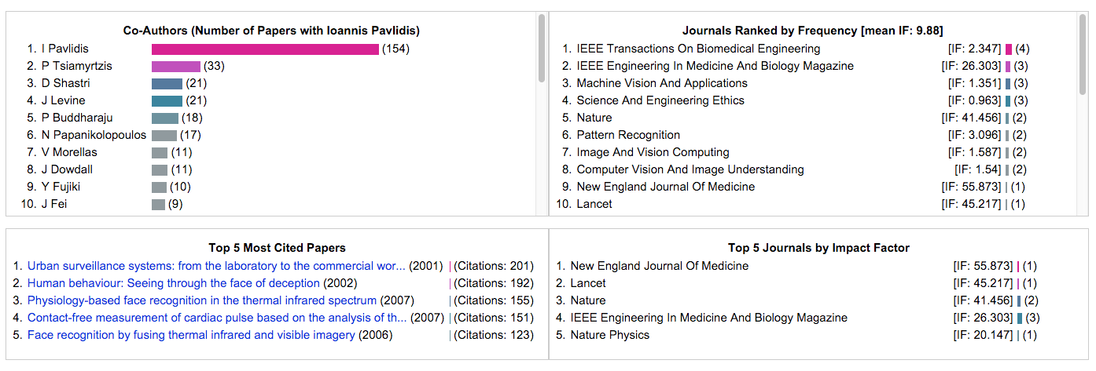
Evaluation - Focus group
Focus group (n=12) at Northwestern University
Resulting improvements: Four ancillary panels
Team science profile
Prestige + impact details
Team
Prestige
Impact
Notes:
through a focus group
I added 4 panels below scholar plot results.
Team science information.
- the number and intensity of collaborations for the depicted scholar.
Impact information
- Summarize highly cited papers.
Prestige information
- the specific journals where the scholar publishes most often and their impact factors.

Slide 23
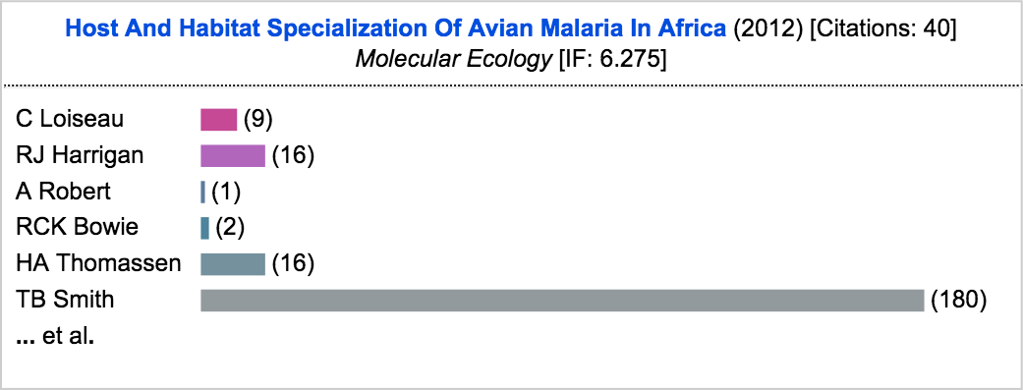
Design Methods – Details on Demand
Tooltip for details
Title, Year of Publication, Citation number, Journal [Conference, Patent] name and Impact Factor value
Co-Author list with bars representing the strength of collaboration history
Notes:
We have another feature that interact an each plot.
When you interact with a plot, it shows the tooltip, which includes paper title, year of publication, the number of citations, journal or conference name and journal impact factor.
this is optional

Slide 24
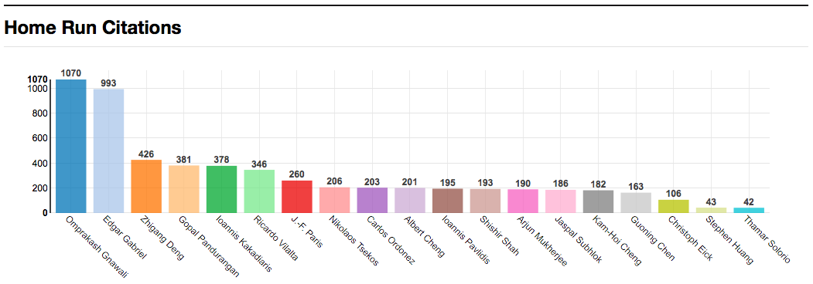
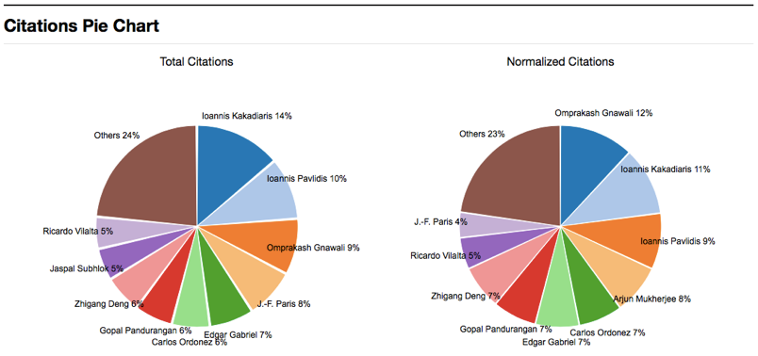
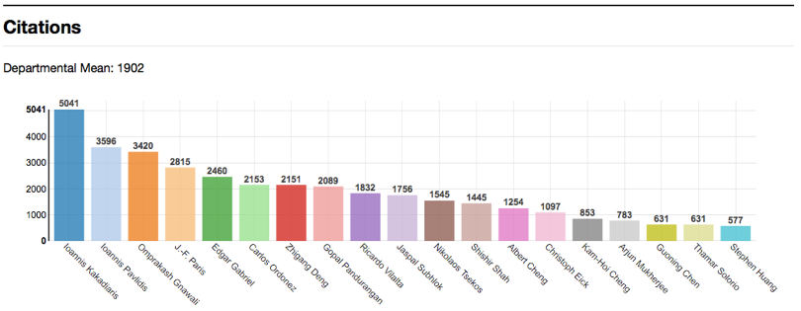
Design Methods – Department Plot
Impact: post-production merit

Slide 25
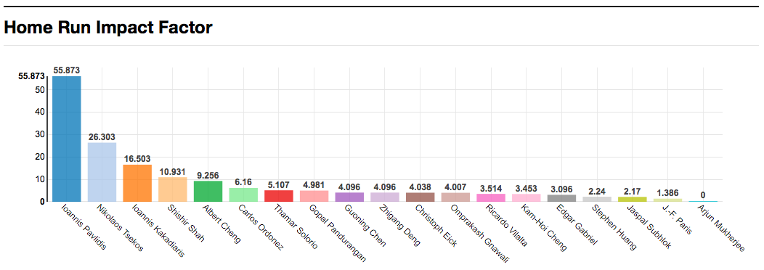
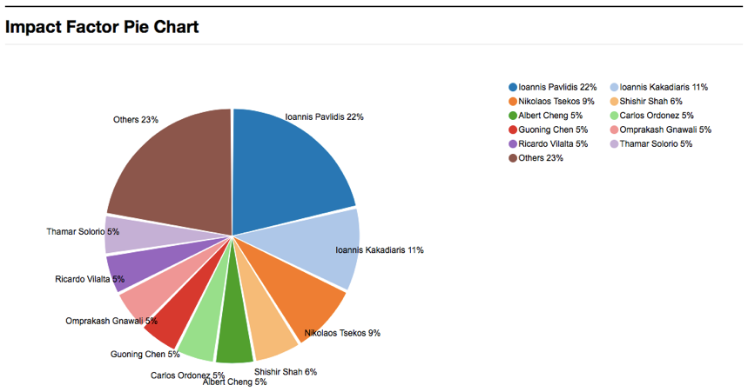
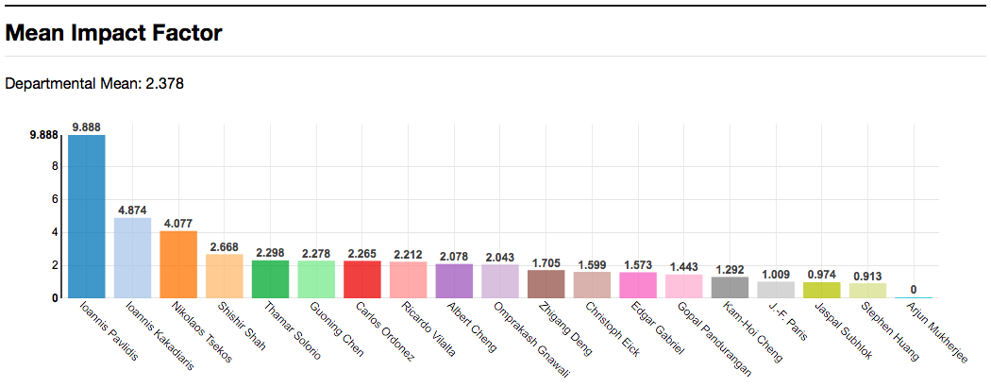
Design Methods – Department Plot
Prestige: pre-production merit

Slide 26
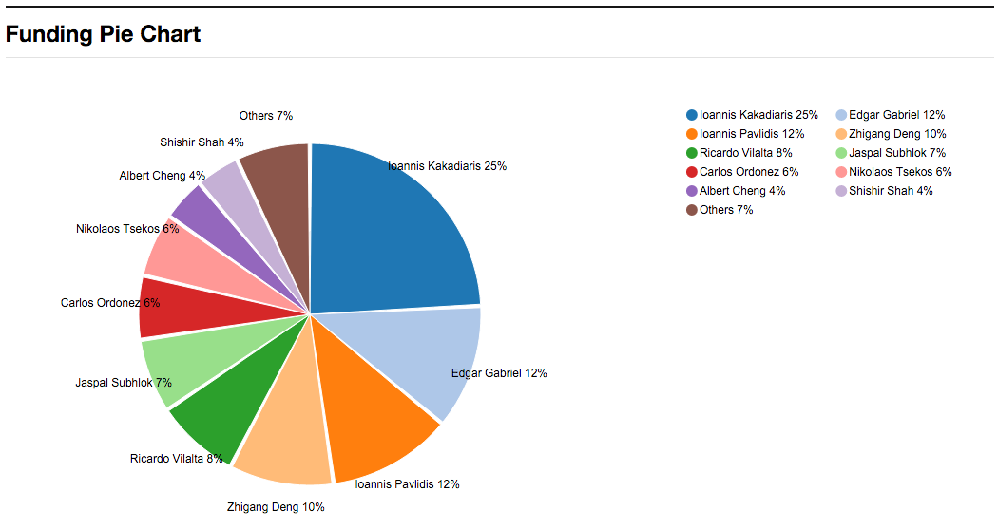
Design Methods – Department Plot
Funding: Enabler of production

Slide 27
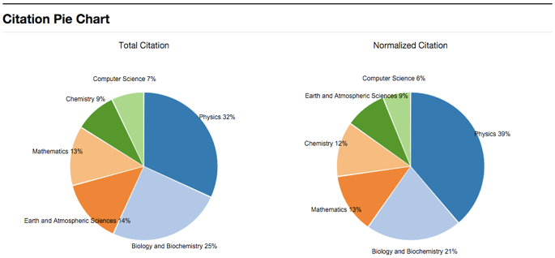
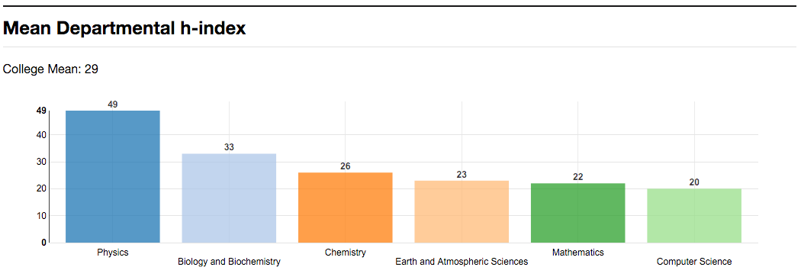
Design Methods – College Plot
Natural Sciences and Mathematics, University of Houston
Impact, Prestige

Slide 28
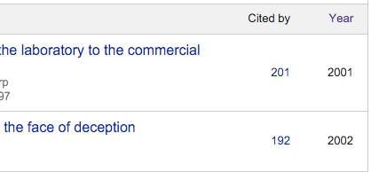

Data Sources
Impact – Citations from Google Scholar
Prestige – Impact Factor from Thomson Reuters
Funding – NSF/NIH/NASA from Government
NSF: FY 1985 - FY 2013 (29 years, 312,311 rows, 10,769/year)
NIH: FY 2000 - FY 2013 (14 years, 777,657 rows, 55,456/year)
NASA: FY 2007 - FY 2015 (9 years, 16,670 rows, 1,852/year)
Notes:
Data sources
Impact which is citations from Google Scholar
Prestige which is Impact Factor from Thomson Reuters

Slide 29
Architecture
Dynamic data – On Demand
Authors
Impact Factor
NSF, NIH, NASA
Yearly Update
Notes:
User visit to Scholar Plot
Type the scholar name to send HTTP request in Ajax(asynchronous JavaScript and XML) and jQuery
Web server fetches scholar data from Google Scholar Profile with user input parameter
Web server connects database server in order to fetch the data (Author, Impact Factor, Funding information)
Web server returns data as a Json format to user with HTTP response
Web browsers renter the data in SVG using HTML5+CSS

Slide 30
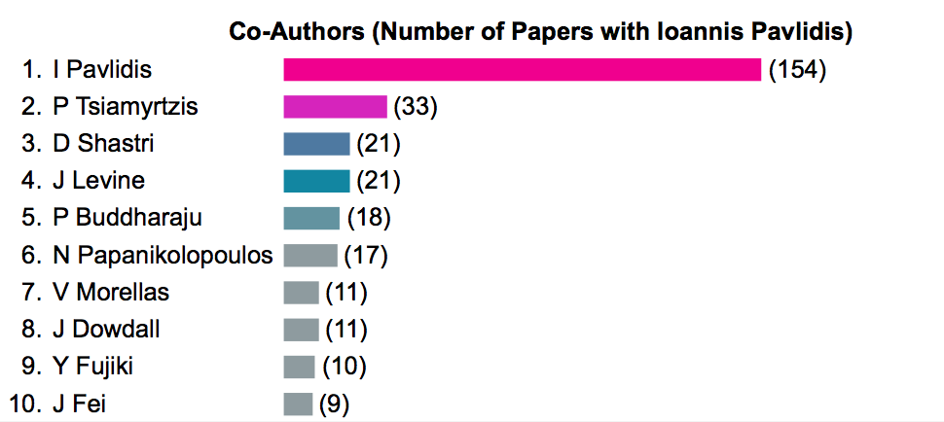
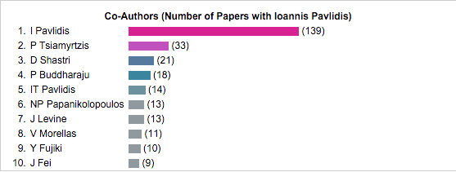
Name Disambiguation
1. Within a Google Scholar profile
Ioannis T Pavlidis
IT Pavlidis
I Pavlidis
Ioannis Pavlidis
I Pavlidis
First Initial + Lastname
Notes:
The biggest problem is middle name

Slide 31
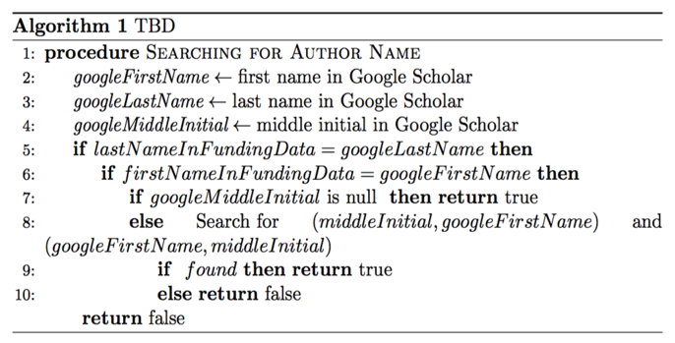
Name Disambiguation
2. Matching Google Scholar name with Funding name
Funding dataset
Remove Jr., III, PhD, Dr., and so on
Google Profile
Funding
Daniel M. Smith
Daniel Michael Smith
M % Daniel
Daniel Michael
Daniel M %
Daniel Michael
Notes:
Matching
Title will be placed
1. remove
2. matching

Slide 32
Goals of Research
GOAL 1: Articulate a clear, comprehensive, and measurable performance evaluation scheme for academics
1.1 : The scheme should reveal causal relationships among merit criteria
Funding + pre-production credit + post-production credit
1.2: The scheme should be scale invariant
Individual or Department or College (composite personhood)

Slide 33
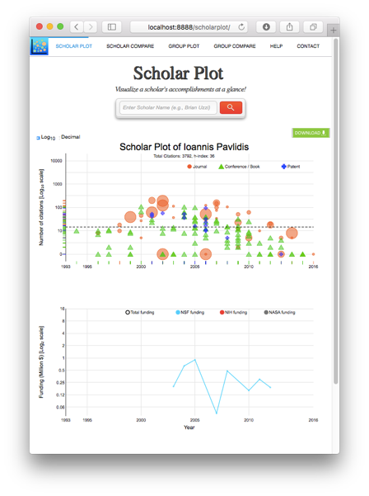
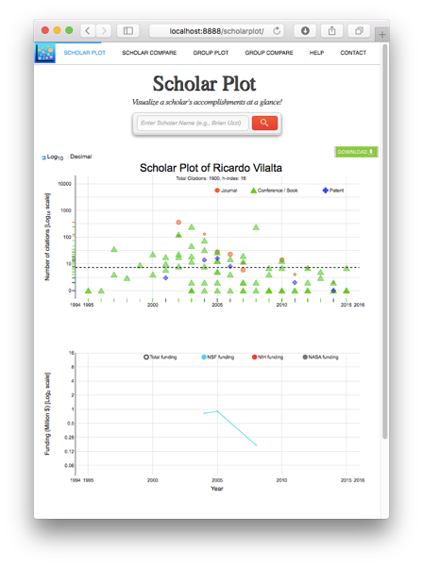
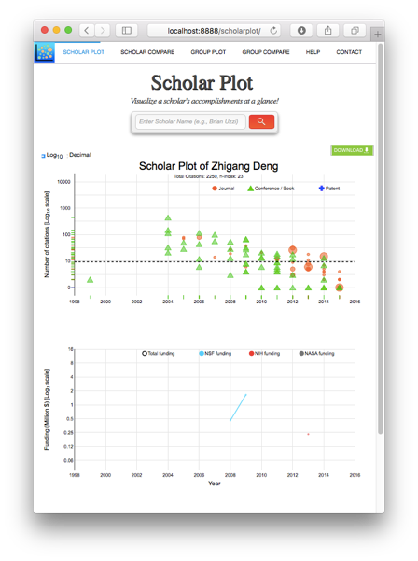
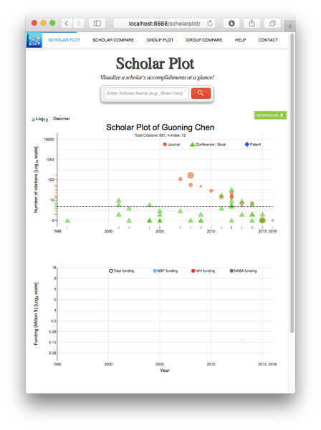
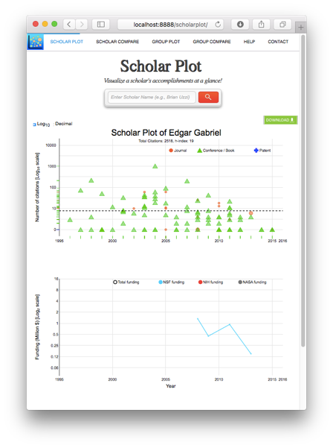
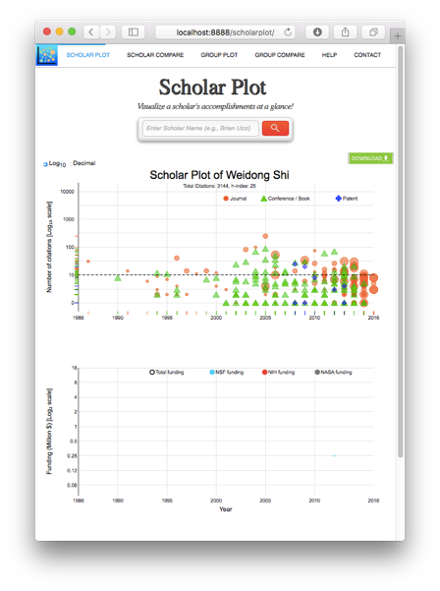
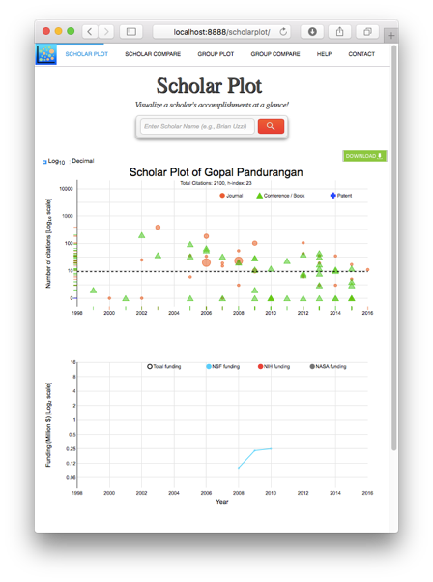
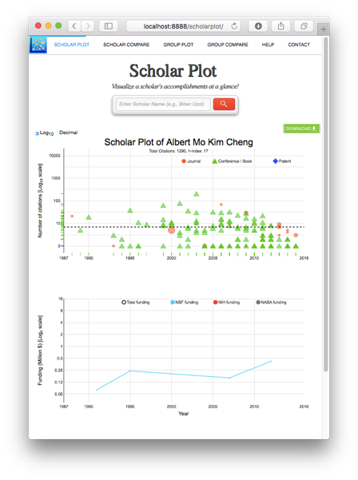
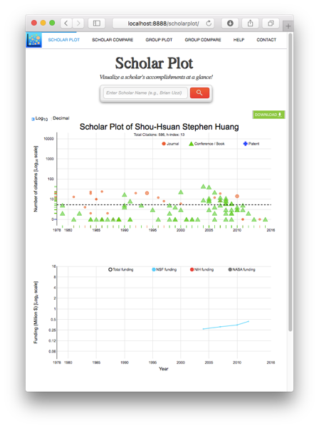
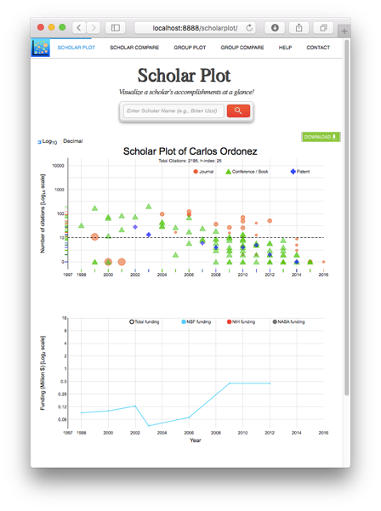
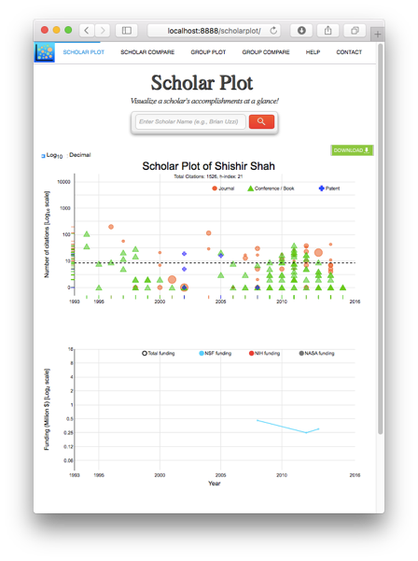
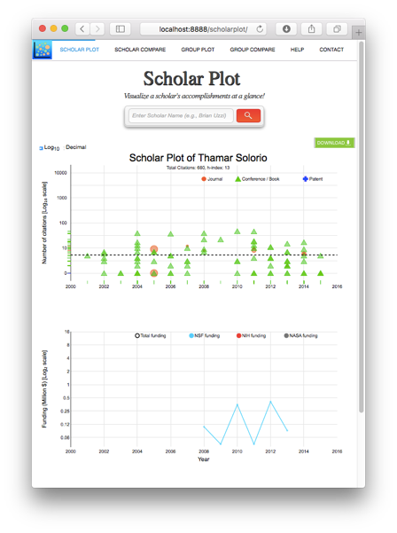
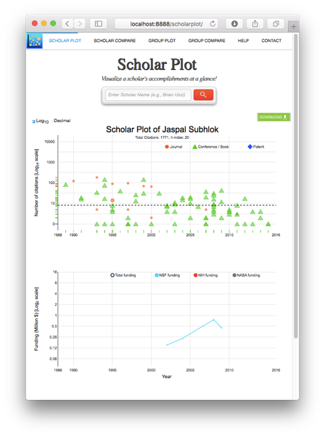



Goals of Research
GOAL 2: Design a visualization to bring the said performance evaluation scheme to life
Scholar Plot is good for individuals
Not scalable to groups
No!!!

Slide 34
Goals of Research
GOAL 1: Articulate a clear, comprehensive, and measurable performance evaluation scheme for academics
1.1 : The scheme should reveal causal relationships among merit criteria
Funding + pre-production credit + post-production credit
1.2: The scheme should be scale invariant
Individual or Department or College (composite personhood)
GOAL 2: Design a visualization to bring the said performance evaluation scheme to life
Scholar Plot is good for individuals
Not scalable to groups
GOAL 3: Implement and test the said visualization, drawing from actual public data
Scholar Plot draws from Google Scholar, Thompson Reuters, and OpenGov
It is a public product working flawlessly! (ScholarPlot.com)
Scaling interface was still pending
← Done
← Done
← Work-in-progress
← Done
← Work-in-progress
Notes:
I presented Scholar Plot (SP), a compact and scalable (individual-department-college) visualization interface for academic merit. We released SP at http://scholarplot.com.
The basic idea behind SP is to facilitate instant deeper insights regarding different strengths of academic records, supporting the work of evaluation committees and the curious academic in search of an advisor or department. One of SP’s strengths is that it draws data from open sources that are inclusive.

Slide 35
Transforming to ‘Academic Garden’
Prestige
Impact
Funding

Slide 36

How to read a flower
Notes:
1. Funding information - NSF/NIH/NASA
2. Citation
3. Impact Factor - size and colors

Slide 37


Scaling Individual to Department
Computer and Information Science at Northeastern University
Notes:
You can simply understand the concept and information of department

Slide 38



Scaling Department to College
Natural Sciences and Mathematics at University of Houston
Biology and Biochemistry
Earth and Atmospheric Sciences
Physics

Slide 39

Inside the Academic Garden
Academic Garden
Scalable visual interface
Front-end to Scholar Plot, Department Plot, College Plot
College of …..
Prestige
Citations
Impact
Funding
Good
Better
Wait...
Oh...

Slide 40


Academic Garden
Northeastern University - Computer and Information Science
CIP Code - developed by the U.S. Department of Education's National Center for Education Statistics (NCES)
Local – same department
Global – same discipline
Notes:
Local - Local scale Y-axis is automatically scaled to the highest citation received by faculty in the department. Quartiles are calculated using the faculty within the same department. Citation / Impact Factor / Funding
Global – Quartiles are calculated using the faculty within the same discipline.
We used CIP (The National Center for Education Statistics designed the Classification of Instructional Program) codes to map the departments to disciplines.
In Global, scale below the cloud is fixed with 20,000 which is 90 percentile of all faculty. scale above the cloud is fixed with 300,000 which is approximately the highest citation of faculty

Slide 41


Academic Garden
MIT - Electrical Engineering and Computer Science
Local - same department
Global - same discipline
Notes:
Guess how do you think local,
Truly everyone in department are good.

Slide 42


Academic Garden
University of Houston - Computer Science
Local – same department
Global – same discipline

Slide 43
Data Analysis
Computer Science
Sample size (n=248) at Top 10 Computer Science
Chaired professor (n=61) at Top 10 Computer Science
Biology
Sample size (n=152) at Top 10 Biology
Chaired professor (n=32) at Top 10 Biology
Top 10 based on US News College Rankings
Chaired professor data is from department’s websites
Notes:
To validate design choices – prominent group (chaired)
1. Ground truth (standard, base)
2. Linear Model – proof
3. Variables - Mirror to visualization
I ran data analysis for validation of academic garden design.
CS – n= 248 of 515 , n=61 of 130
Bio – n=152 of 381 , n=32 of 97

Slide 44

Data Analysis – Computer Science
Linear Model: At Least 1 Top - Local Quartile
Notes:
This linear model evaluates the correlation chaired professors with the three variables displayed in Academic Garden.
Total Citations, Mean IF, Total Funding (NSF, NIH, NASA)
Is_chair (1) – if the faculty is in the top quartile for either of the 3 criteria – funding, mean IF, total citations
Is_chair (0) – if the faculty is not in the top quartile for all the three criteria
Quartiles are calculated with respect to the department to which the faculty belongs to.
ex., if a faculty is in the top quartile for citations but not for funding and impact factor, he still gets 1 according to this measure/metric

Slide 45

Data Analysis – Computer Science
Linear Model: All Local Quartile
Notes:
All three criteria as separately factors
In computer science, citations are very important. And you can clearly see the chaired faculty. Significantly related to citation.
Because they don’t publish so much journals, impact factor are not significant. Also, our funding sources are not included everything which computer science faculty received funding from.

Slide 46

Data Analysis – Biology
Linear Model: Local Quartiles for Total Funding
Notes:
local_top_q_any_of_three
1 – if the faculty is in the top quartile for either of the 3 criteria – funding, mean IF, total citations
0 – if the faculty is not in the top quartile for all the three criteria
Quartiles are calculated with respect to the department to which the faculty belongs to.
ex., if a faculty is in the top quartile for citations but not for funding and impact factor, he still gets 1 according to this measure/metric

Slide 47

Data Analysis – Biology
Linear Model: All Local Quartiles
Notes:
All three criteria as separately factors
In computer science, citations are very important. And you can clearly see the chaired faculty. Significantly related to citation.
Because they don’t publish so much journals, impact factor are not significant. Also, our funding sources are not included everything which computer science faculty received funding from.

Slide 48

Data Analysis – Biology
Linear Model: All Global Quartile
Notes:
Linear Model: Academic Garden
This linear model evaluates the correlation chaired professors have with the three variables displayed in Academic Garden.
Why ? Validate design choices – prominent group (chaired)
1. Ground truth (standard, base)
2. Linear Model – proof
3. Quartile - Mirror to visualization
This data analysis validates the design choice of the three criteria for our visualization!

Slide 49
Conclusion
GOAL 1: Articulate a clear, comprehensive, and measurable performance evaluation scheme for academics
1.1 : The scheme should reveal causal relationships among merit criteria
Funding + pre-production credit + post-production credit
1.2: The scheme should be scale invariant
Individual or Department or College (composite personhood)
GOAL 2: Design a visualization to bring the said performance evaluation scheme to life
Scholar Plot is good for individuals
Not scalable to groups
GOAL 3: Implement and test the said visualization, drawing from actual public data
Scholar Plot draws from Google Scholar, Thompson Reuters, and OpenGov
It is a public product working flawlessly! (ScholarPlot.com)
Scaling interface is still pending
Validates the design choice of the three criteria for the visualization
← Done
← Done
← Done
Notes:
We presented Scholar Plot (SP), a compact and scalable (individual-department-college) visualization interface for academic merit. We released SP at http://scholarplot.com.
The basic idea behind SP is to facilitate instant deeper insights regarding different strengths of academic records, supporting the work of evaluation committees and the curious academic in search of an advisor or department. One of SP’s strengths is that it draws data from open sources that are inclusive.

Slide 50


PhD Timeline
Activities / Membership
2012 PhD Student Association Officer
2014 Computer Science PhD Showcase
2014 Graduate Research and Scholarship Projects (GRaSP)
2015 Graduate Research and Scholarship Projects (GRaSP)
2016 Volunteering Judges
Conference Presentations
K Kwon, "Design Principles: Information Visualization in User Studies", Proceedings of the 2015 US-Korea Conference on Science, Technology and Entrepreneurship, UKC 2015 Atlanta
K Kwon, "Interfacing Information with Mixed Methods", Proceedings of the 2014 US-Korea Conference on Science, Technology and Entrepreneurship, UKC 2014 San Francisco, CA
Fall 2011
(1st year)
Fall 2013
(3rd year)
Spring 2016
Fall 2015
(5th year)
Fall 2012
(2nd year)
Fall 2014
(4th year)
Spring 2012
Spring 2014
Spring 2013
Spring 2015
Released
Released
Switched Lab
M.S.
J Lee, Z Liu, X Tian, D Woo, W Shi, D Boumber, Y Yan, and K Kwon, "Acceleration of Bulk Memory Operations in a Heterogeneous Multicore Architecture", 21st International Conference on Parallel Architectures and Compilation Techniques, PACT 2012, Minneapolis
K Kwon, D Shastri and I Pavlidis "Information Visualization in Affective User Studies", The IEEE Visual Analytics Science and Technology, IEEE Information Visualization, and IEEE Scientific Visualization, VIS 2014, Paris, France
S Taamneh, M Dcosta, K Kwon and I Pavlidis "SubjectBook: Web-based Visualization Of Multimodal Affective Datasets", ACM Human Factors in Computing Systems, CHI 2016, San Jose, CA
T Feng, Z Liu, K Kwon, W Shi, B Carbunar, Y Jiang and N Nguyen, "Enhancing Mobile Security with Continuous Authentication Based on Touchscreen Gestures", The twelfth annual IEEE Conference on Technologies for Homeland Security, HST 2012, Waltham, MA
K Kwon, D Shastri and I Pavlidis "Interfacing Information in Affective User Studies", The 2014 ACM International Joint Conference on Pervasive and Ubiquitous Computing, Ubicomp 2014, Seattle, WA
D Majeti, K Kwon, P Tsiamyrtzis and I Pavlidis "Dissecting Scholarly Patterns in Biology and Computer Science", The Science of Team Science, SciTS 2015, Bethesda, MD

Slide 51
Acknowledgments
Committee
Dr. Ioannis Pavlidis (Dept. of Computer Science) – Chairman
Dr. Zhigang Deng (Dept. of Computer Science)
Dr. Guoning Chen (Dept. of Computer Science)
Dr. Brian Uzzi (Northwestern University)
All our CPL members
Dr. Dvijesh Shastri, Dr. Malcolm Dcosta
Dinesh, Salah, Muhsin, Ashik
Notes:
I would like to thank Dr. Pavlidis being my research advisor. And I would like thank each of you for serving on my committee.
Done.

Slide 52
Demo
Scholar Plot

Slide 53
Thank you!

